Slide 1
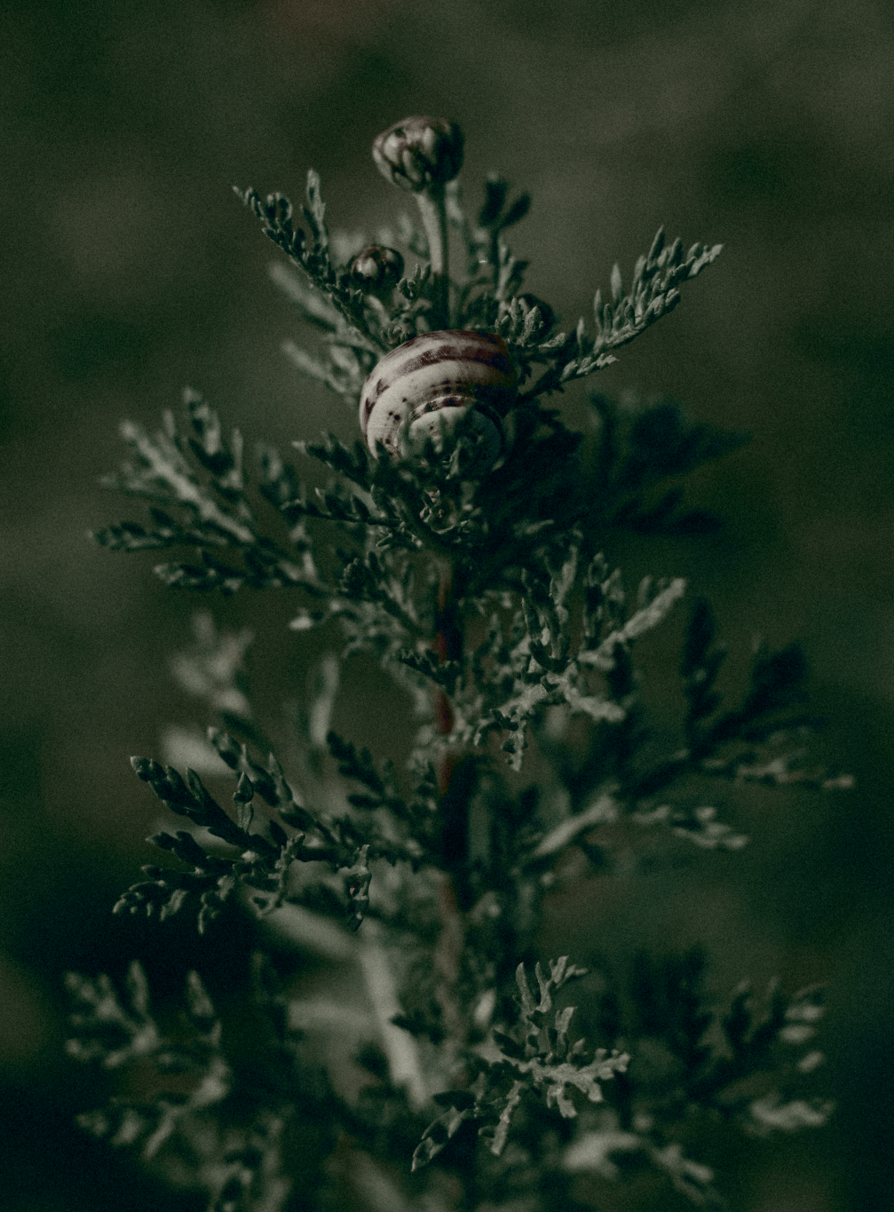
EchoFrames
Echoframes is an innovative photography project dedicated to visualizing environmental sustainability through compelling visual storytelling.

Slide 2

EMPATHIZE

Slide 3
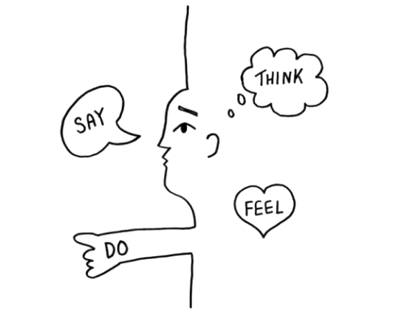
Understanding Users : Empathy Mapping
"I want a sleek, professional website to showcase my work."
"My photos should speak for themselves without too much clutter."
"I want easy navigation for my visitors."
"Is my work good enough to attract clients?"
"How will clients contact me through the website?"
Excited about displaying their best work. Nervous about their site’s drst impression. Anxious about missing out on potential clients.
Browse competitor websites for inspiration.
Constantly tweak and upload images. Share their website on social media or professional platforms.
Respond to inquiries via email or forms.

Slide 4
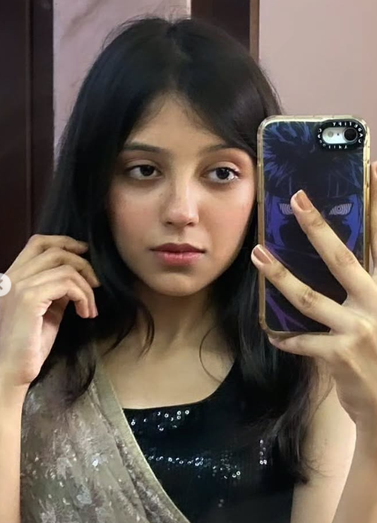
Personas
Shubhangi- Student
Age: 21 Location: Delhi, India Occupation: Media Studies Student (3rd Year)
Background: Riya is a self-taught photographer passionate about street and event photography. She covers college events and takes small freelance gigs to fund her dream of becoming a professional photographer.
Goals:
Showcase her portfolio online.
Attract gigs and collaborations.
Connect with mentors and peers.
Needs:
A simple, affordable website.
Organized photo categories (e.g., Events, Portraits).
Social media integration and a contact form.
Pain Points:
Budget constraints for gear and website design.
Difficulty balancing college and photography.

Slide 5
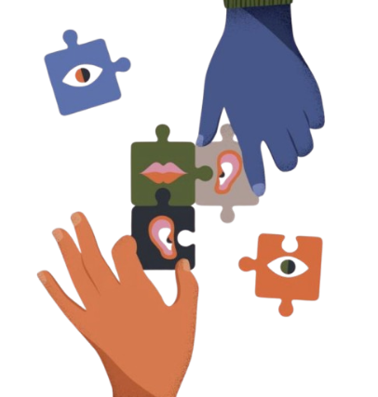
DEFINE

Slide 6
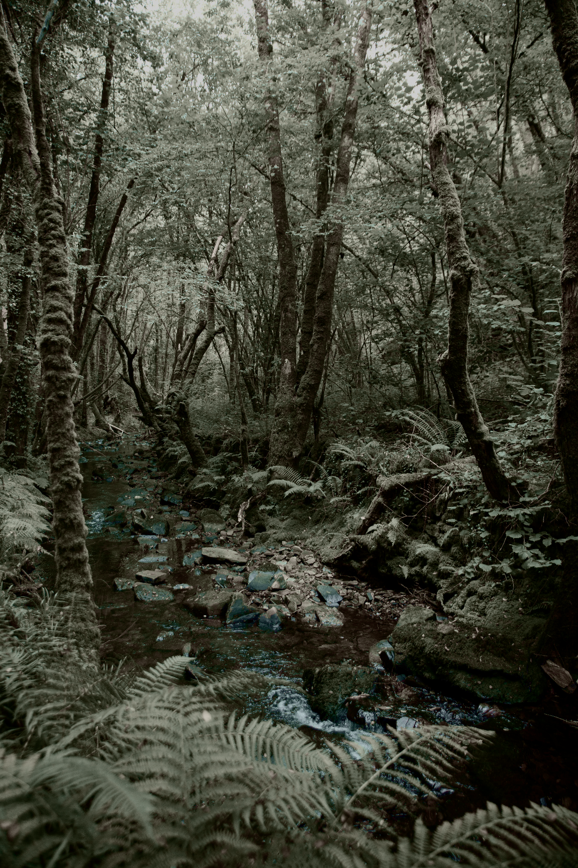
Problem Statement
In an era of digital creativity, photographers and visual artists lack a comprehensive platform that allows them to not only showcase their own diverse photographic genres—including Human Photography, Wildlife, and Nature—but also provide a collaborative space where other creators can upload and share their work. The challenge is developing a dynamic, user-friendly website that serves as both a personal portfolio and a community-driven visual storytelling platform, enabling seamless exploration, interaction, and shared creative expression across multiple photography genres

Slide 7
Defining Key Goals
User Engagement
Offer a seemless browsing and uploading experience to enhance user satisfaction anf interaction with the platform.
Inspiring Design
Creates visually stunning pages that resonate with users ensuring aesthetic appeal and functionality enhance the overall user experience.
Community Building
Facilitate connections between photography enthusiasts, encouraging collaborations, sharing and support within the community.

Slide 8
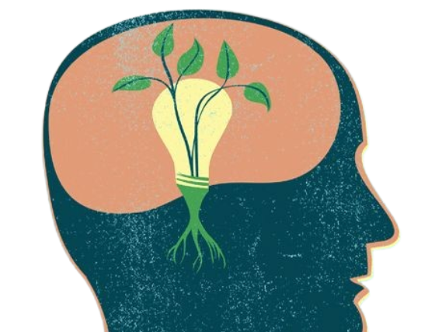
IDEATE

Slide 9
Design Process Insights
Intitial Planning
User Flow
UI/UX Design
Defined project goals and features, establishing a clear direction for the design process.
Focused on simplicity, vibrancy, and smooth transitions to engage users effectively.
Designed a seamless journey from homepage to galleries, optimizing navigation and accessibility.
WireFraming
Responsive Design
Created layout drafts to facilitate easy navigation and enhance user experience.
Ensured compatibility across devices, providing a seamless experience on desktops, tablets, and smartphones.

Slide 10




TOOLS AND TECHNOLOGIES USED
HTML5
CSS3
Provides the fundamental structures of the website, including essential elements like headers, footers and sections.
Enhances the visual appeal through styling and animations. Utilizes Flexbox for effective layout management and media queries for mobile responsiveness.
Images
External Links
Utilizes high-quality visuals sourced from various photography genres to create an appealing and immersive user experience.
Facilitates navigation to genre-specific gallery pages, enriching user interaction and accessibility to content.

Slide 11
CHALLENGES AND SOLUTIONS
01
02
03
04
05
06
Responsive Design
Slideshow Transtions
User-Friendly Gallery
CSS Media Queries
CSS Animations
Categorized Galleries

Slide 12
PROTOTYPE

Slide 13
Prototyping the Website
Gallery
Create Account
This section displays a grid of four icons representing different categories of photos - Nature, Animals, Paradise, and Humans. These icons likely serve as entry points to browse and view photos within those categories.
A section for users to sign up and create an account on the website, including fields for name, email, password, and gender.
User Features
About Us
The prototype suggests that users will be able to showcase their own photography skills, share their creativity with the world, and browse through others' projects to find inspiration.
This section provides an overview of the EchoFrames project, emphasizing their mission to capture the beauty of life through photography and create a platform for visual storytelling and environmental advocacy.

Slide 14
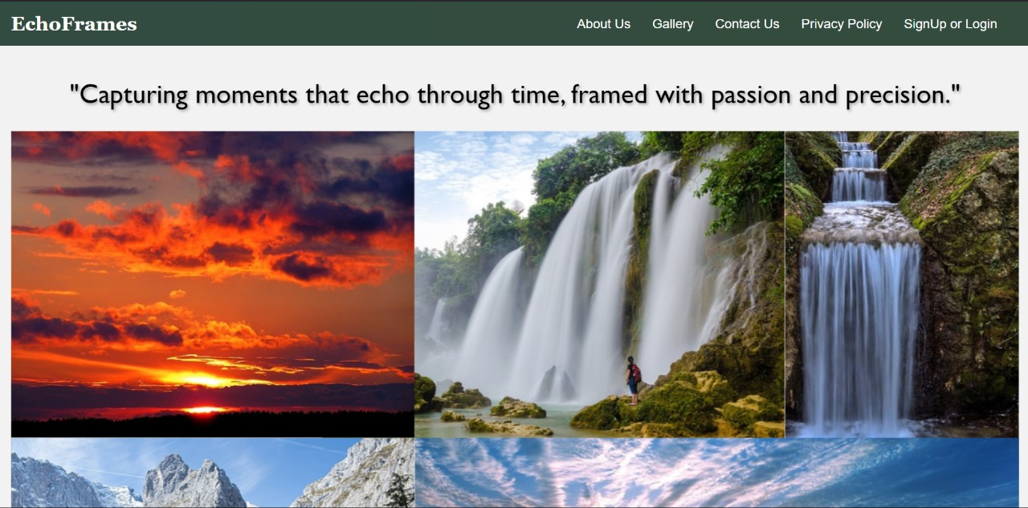
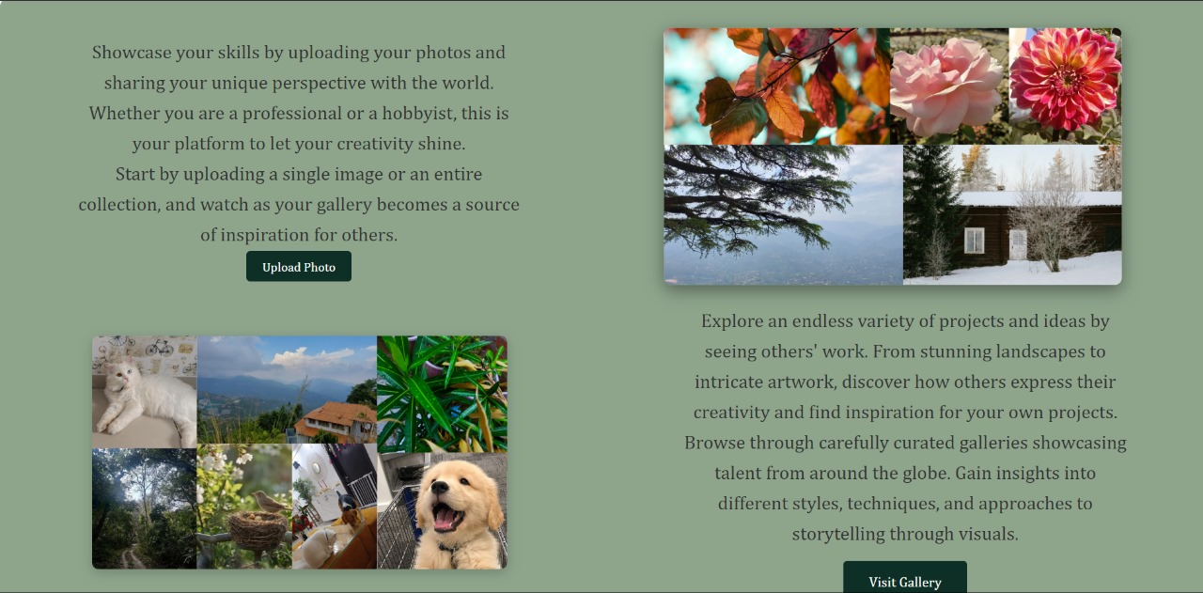
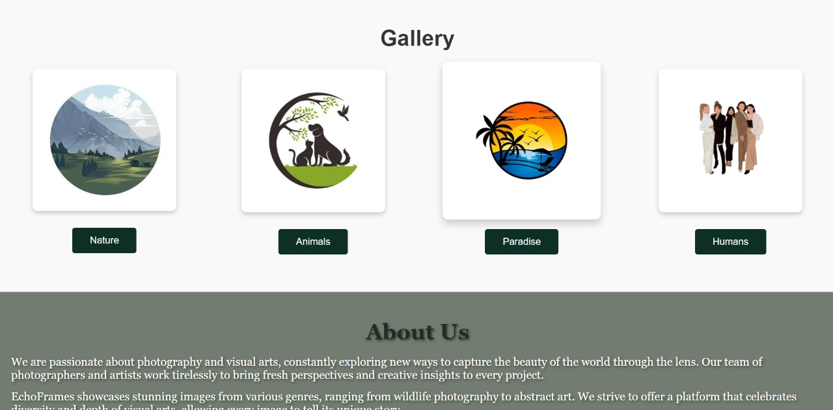
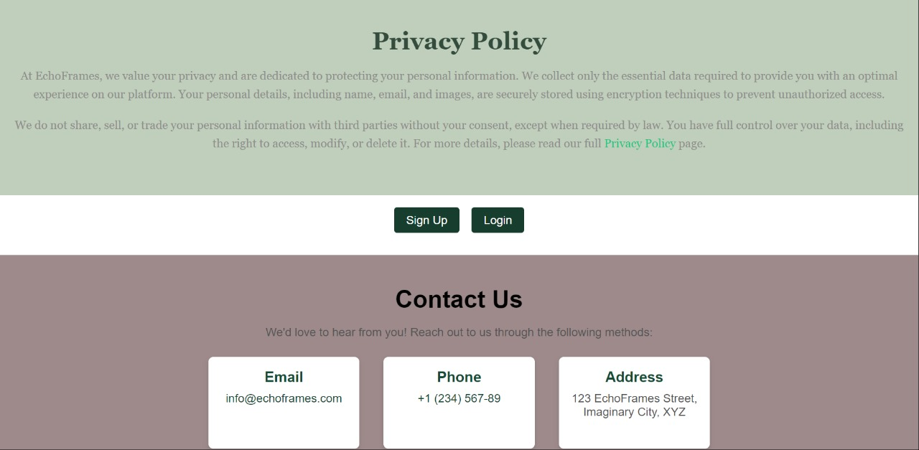
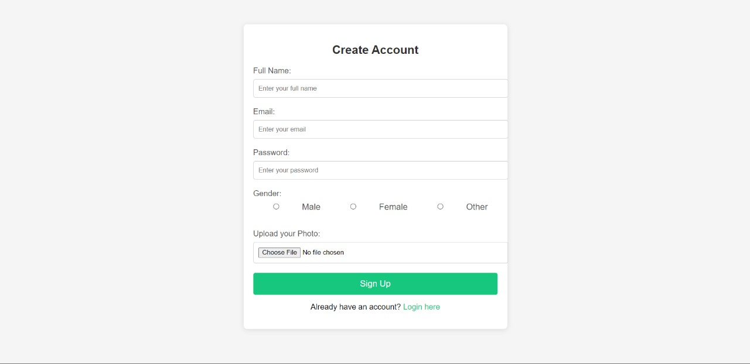
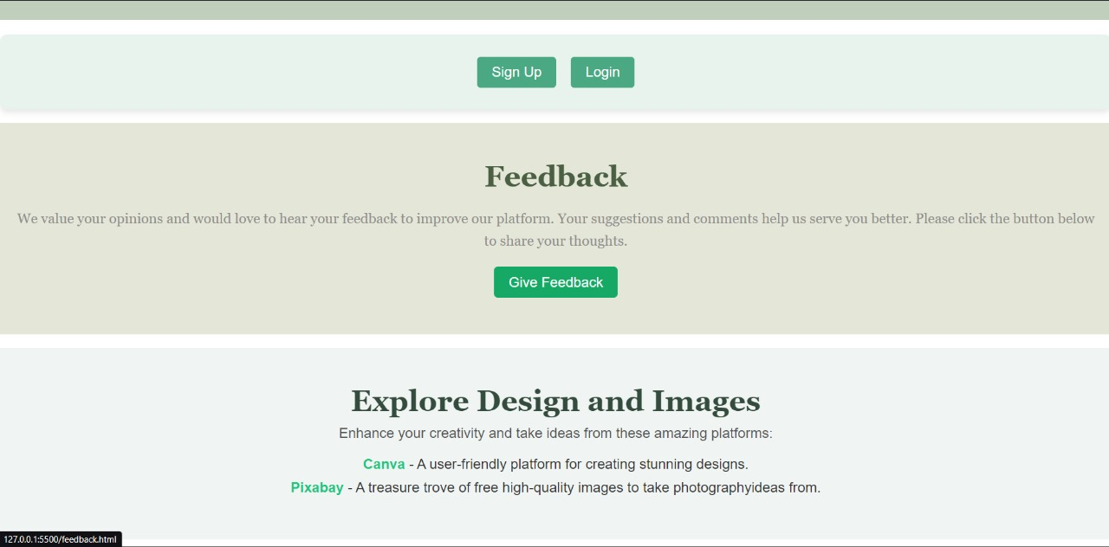
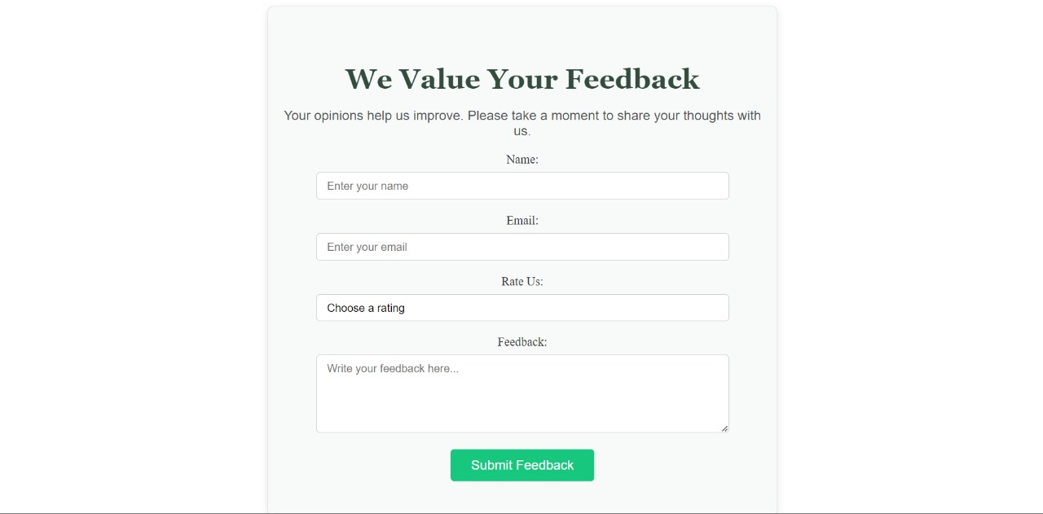
Photo showcase

Slide 15
Photo showcase

Slide 16
Photo showcase

Slide 17
Photo showcase

Slide 18
Photo showcase

Slide 19
Photo showcase

Slide 20
Photo showcase

Slide 21

FEEDBACK

Slide 22
FEEDBACKS AND SOLUTIONS
User complaint about Website being too dark so the website theme was altered and light colours were used instead.
Feedback 1:
The user recommended to add visual icons for navigation buttons used for different genres of photos.
Feedback 2:
User recommended to add links to similar websites for more ideas, we added the same.
Feedback 3:

Slide 23
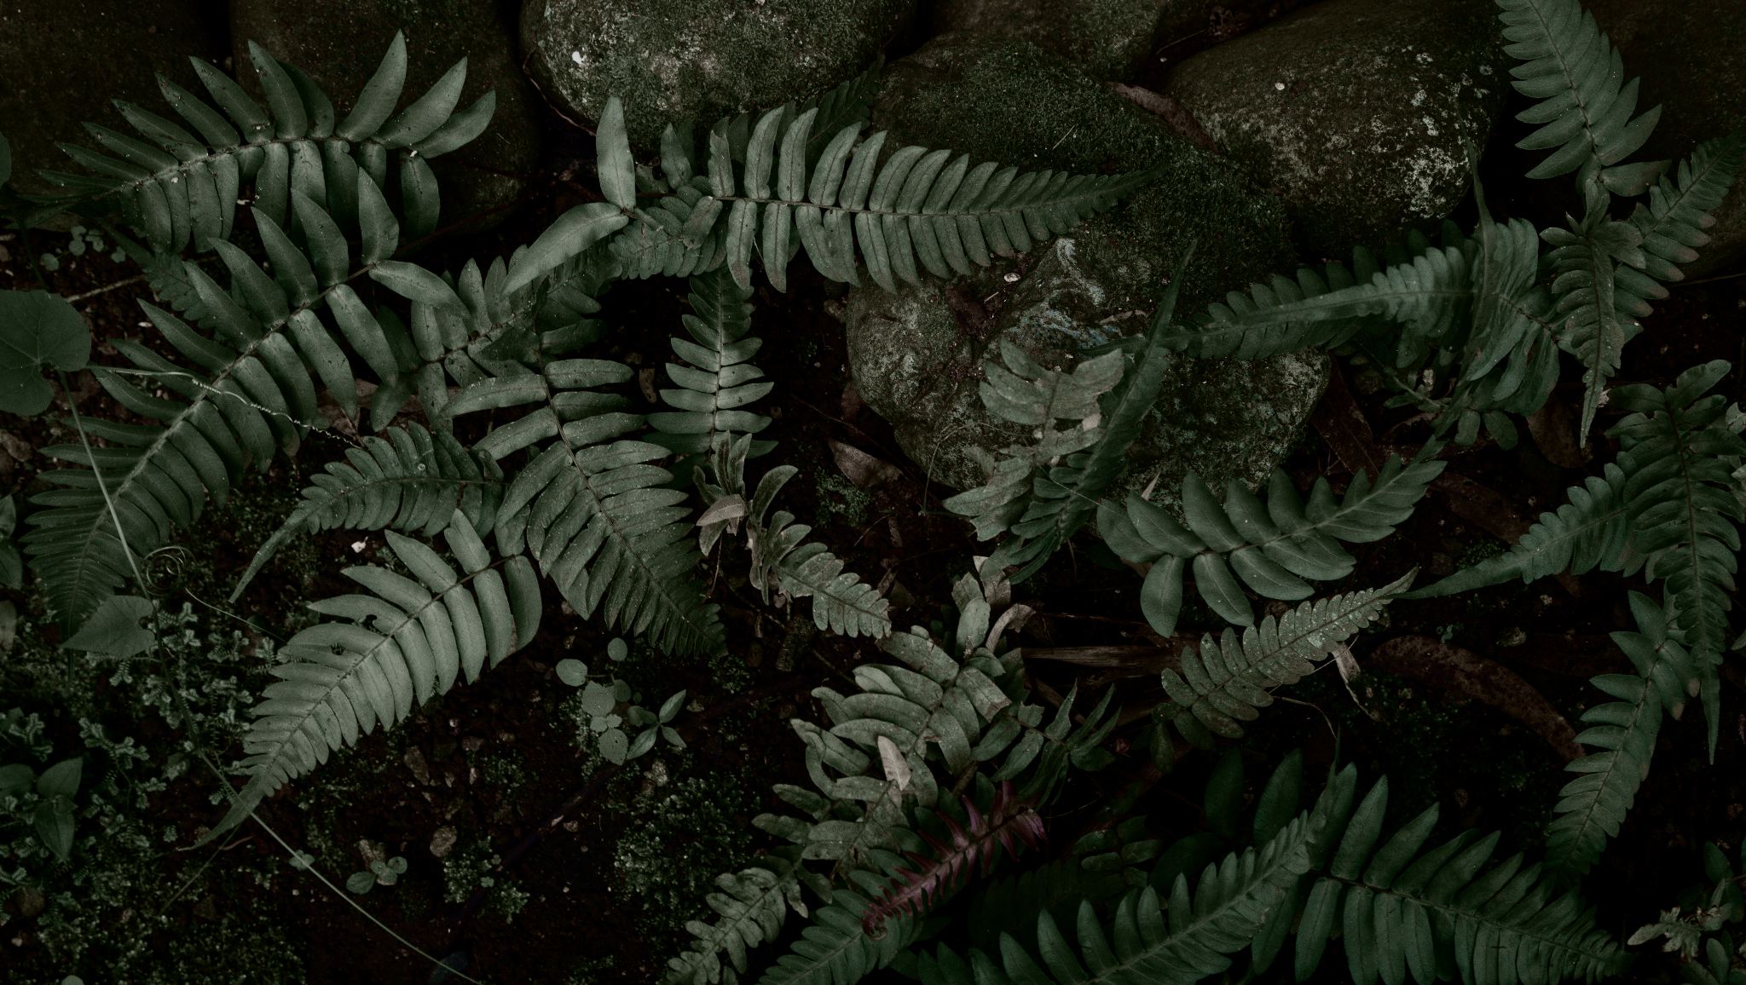
"Creativity is the key to unlocking your true potential"

